Slide 1
Digital Portfolio
STUDENT NAME:SATHANA D
REGISTER NO AND NMID: 2428C0513 AND
947883C0E79F35697424871A6A59D779
DEPARTMENT: Bsc AI&ML
COLLEGE: KPR College of Arts & Science,Bharathiyar Un

Slide 2
PROJECT TITLE
Robotics Engineer Portfolio

Slide 3


AGENDA
Problem Statement
Project Overview
End Users
Tools and Technologies
Portfolio design and Layout
Features and Functionality
Results and Screenshots
Conclusion
Github Link
3/21/2024 Annual Review

Slide 4

PROBLEM STATEMENT
In today’s fast-paced digital world, managing events, projects, and personal achievements often becomes difficult without a proper system. Traditional methods lack organization, accessibility, and professional presentation. A well-structured portfolio/project system is required to showcase skills, projects, and accomplishments effectively.

Slide 5

PROJECT OVERVIEW
This project is designed as a personal portfolio system that highlights academic background, technical skills, achievements, and projects in a structured manner.
The portfolio provides an interactive and user-friendly platform to represent an individual’s professional journey and expertise.

Slide 6

WHO ARE THE END USERS?
Students – To showcase their projects, skills, and achievements.
Professionals – To build a personal brand and highlight work experience.
Recruiters/Employers – To evaluate the candidate’s capabilities.
Institutions – To present academic or project-based work.

Slide 7

TOOLS AND TECHNIQUES
Frontend: HTML5, CSS3, JavaScript
Styling/Frameworks: Bootstrap / Tailwind CSS (optional)
Animations & Effects: JavaScript, CSS animations, 3D effects
Version Control: Git & GitHub

Slide 8
POTFOLIO DESIGN AND LAYOUT
Home Page – Introduction with name, role, and personal details.
About Section – Academic background and personal information.
Skills Section – Technical and soft skills represented visually.
Projects Section – Detailed description of projects with links/screenshots.
8

Slide 9
FEATURES AND FUNCTIONALITY
Responsive and mobile-friendly design.
Interactive UI with hover and 3D effects.
Easy navigation across all sections.
Integration with GitHub for project repositories.
Downloadable resume option.
Visual representation of skills using progress bars or charts.

Slide 10
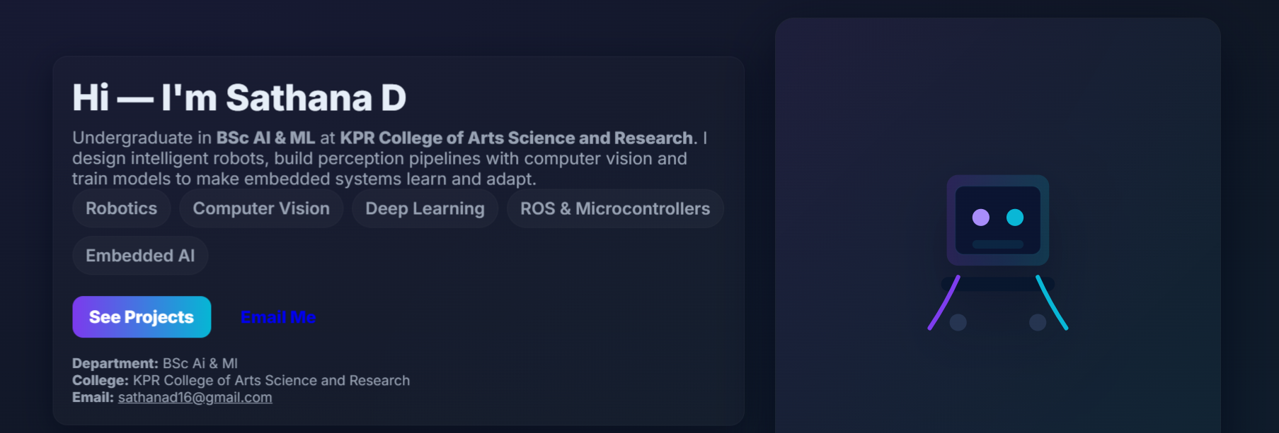

RESULTS AND SCREENSHOTS
3/21/2024 Annual Review
10

Slide 11
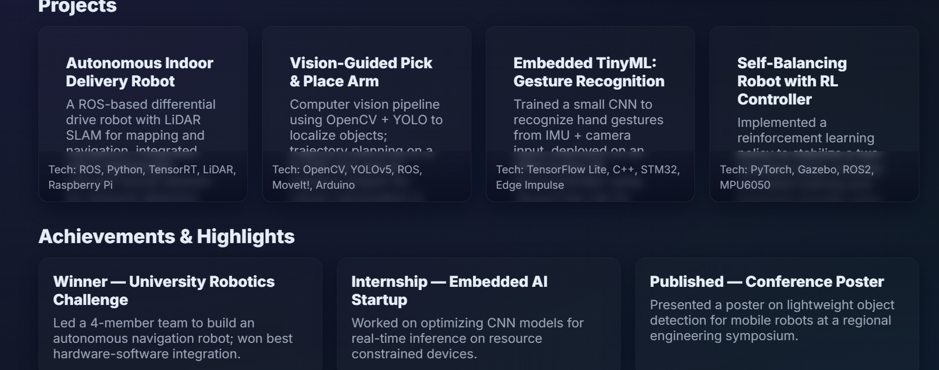
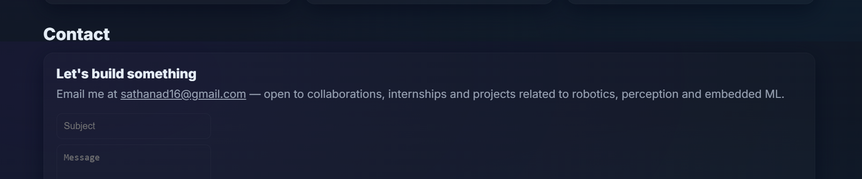
RESULTS AND SCREENSHOTS

Slide 12
CONCLUSION
The portfolio effectively demonstrates an individual’s skills, projects, and achievements in a visually appealing and structured way.
It enhances personal branding, supports academic/professional growth, and serves as a digital resume accessible anytime, anywhere.
12

Slide 13
GitHub Link:
https://github.com/sathanad16-eng

